Slide 1
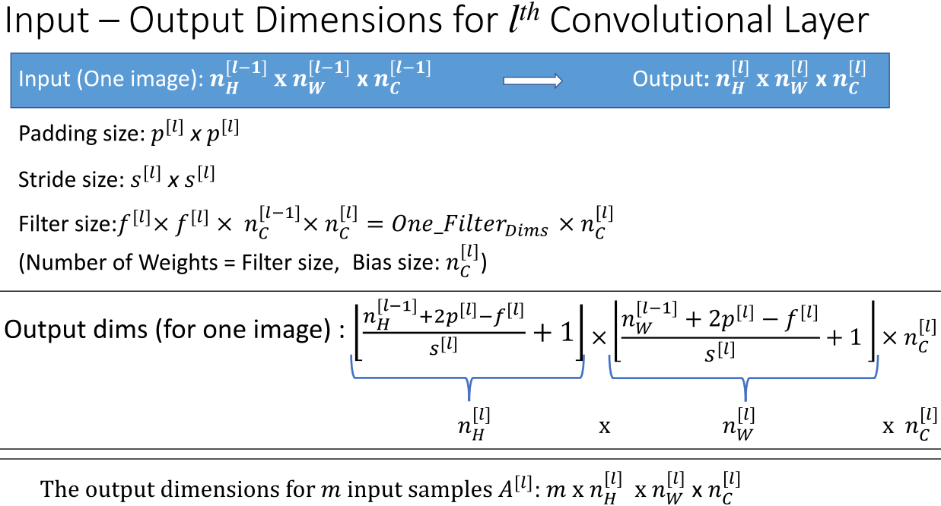
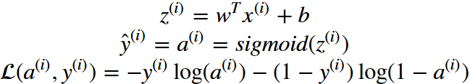
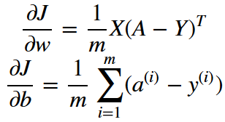
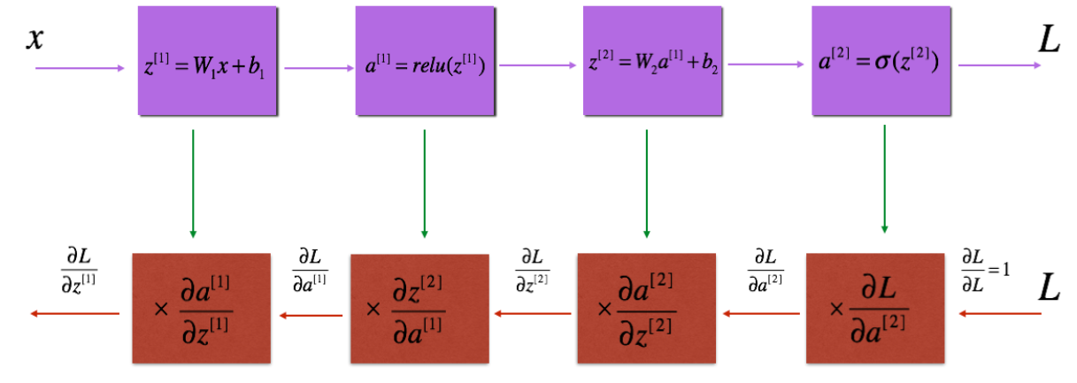
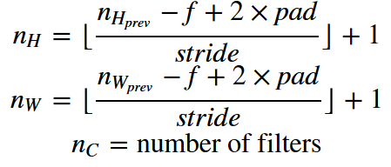


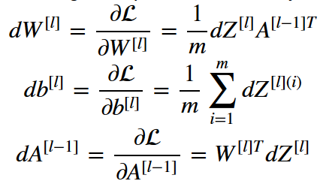



Logistic Regresstion HW 1:
1.Flatten images to be a single matrix
train_x_flat = train_x_prep.reshape(m_train, -1).T
Sigmoid: s = np.divide(1, (np.add(1, np.exp(-z))))
Propagation:
* Save all the input data in a single matrix X
* Compute all the outputs in the matrix
** sigmoid(wt * X + b)
* Calculate cost function
Forward:
m = X.shape[1] (total number of X inputs)
A = sigmoid(z)
cost = -(1/m) * np.sum(np.multiply(Y, np.log(A)) + np.multiply((1-Y), np.log(1-A)))
Backward:
dw = np.dot(X,(A-Y).T)/m
db = np.sum(A-Y)/m
Optimization:
for i in range(num_iters):
grads, cost = propagate(w, b, X, Y)
w = w - learning_rate*dw
b = b - learning_rate*db
Combine:
* Initialize params w and b
* Optimize based off of training data
** forward, backward propagation
** sigmoid and cost
** gradients (slope) derivatives
** obtain new w and b via
** use those to predict data
Multi-Layer Neural Networks HW2:
* Initialize W and b parameters
** Wl -- weight matrix of shape (layer_dims[l], layer_dims[l-1]) bl -- bias vector of shape (layer_dims[l], 1)
* Linear forward
** Z = W.dot(A) + b
** cache = (A, W, b)
** need to cache for backwards propagation
** feed z into activation function
** sigmoid
** relu -> ReLU(Z) = max(0,Z)
** cache activation and A
Pass each A to each layer
For ReLU:
for l in range(1, L):
A_prev = A
A, cache = linear_activation_forward(A_prev, parameters['W' + str(l)], parameters['b' + str(l)], activation='relu’)
caches.append(cache)
For Sigmoid:
AL, cache = linear_activation_forward(A, parameters['W' + str(L)], parameters['b' + str(L)], activation='sigmoid')
caches.append(cache)
* Compute cost:
m = Y.shape[1]
cost = (-1/m) * (np.dot(Y, np.log(AL).T) + np.dot((1-Y), np.log(1-AL).T))
cost = np.squeeze(cost)
* Backward propagation for linear:
dW = (1/m) * np.dot(dZ, A_prev.T)
db = (1/m) * np.sum(dZ, axis=1, keepdims=True)
dA_prev = np.dot(W.T, dZ)
* find the dW and dB for every hidden layer by multiplying the learning rate by the gradients
for l in range(L):
parameters["W" + str(l+1)] -= learning_rate * grads['dW' + str(l+1)]
parameters["b" + str(l+1)] -= learning_rate * grads['db' + str(l+1)]
ConvNet HW 3:
Functions:
* zero-padding, convolution operation (convolve window), forward convolution, backward convolution
Pooling functions:
* Pooling forward, create mask, distribute value, pooling backward
* Single step of convolution:
Takes an input volume
Applies a filter at every position of the input
Outputs another volume (usually of different size)
Cache parameters
conv_single_step(a_slice_prev, W, b):
a_slice_prev -- slice of input data of shape (f, f, n_C_prev)
W -- Weight parameters contained in a window - matrix of shape (f, f, n_C_prev)
b -- Bias parameters contained in a window - matrix of shape (1, 1, 1)
# Element-wise product between a_slice and W. Do not add the bias yet.
s = np.multiply(a_slice_prev, W)
# Sum over all entries of the volume s.
Z = np.sum(s)
# Add bias b to Z. Cast b to a float() so that Z results in a scalar value.
Z += np.float(b)
* Slice A based off of stride and filter W then
n_H = int((n_H_prev - f + 2*pad)/stride + 1)
n_W = int((n_W_prev - f + 2*pad)/stride + 1)
for i in range(m): # loop over the batch of training examples
a_prev_pad = A_prev_pad[i] # Select ith training example's padded activation
for h in range(n_H): # loop over vertical axis of the output volume
for w in range(n_W): # loop over horizontal axis of the output volume
for c in range(n_C): # loop over channels (= #filters) of the output volume
# Find the corners of the current "slice" (~4 lines)
vert_start = stride * h
vert_end = stride * h + f
horiz_start = stride * w
horiz_end = stride * w + f
# Use the corners to define the (3D) slice of a_prev_pad a_slice_prev = a_prev_pad[vert_start:vert_end, horiz_start:horiz_end, :]
# Convolve the (3D) slice with the correct filter W and bias b, to get back one output neuron.
Z[i, h, w, c] = conv_single_step(a_slice_prev, W[:, :, :, c], b[:, :, :, c])
* Pooling layer
Do same thing as above, but take the max or mean of a_prev_slice
if mode == "max":
A[i, h, w, c] = np.max(a_prev_slice)
elif mode == "average":
A[i, h, w, c] = np.mean(a_prev_slice)
* Back propagation:
Same as above but with:
da_prev_pad[vert_start:vert_end, horiz_start:horiz_end, :] += W[:,:,:,c] * dZ[i, h, w, c]
dW[:,:,:,c] += a_slice * dZ[i, h, w, c]
db[:,:,:,c] += dZ[i, h, w, c]
dA_prev[i, :, :, :] = da_prev_pad[pad:-pad, pad:-pad, :] NEXT STEP IS TO THE LEFT
* Mask
mask = (x == np.max(x))
Replaces x with true if value is largest and false if not
* Pool backwards
Propagate the gradient back through the pooling layer in order to compute gradients for before layer
Same as above but with a_prev_slice = a_prev[vert_start: vert_end, horiz_start: horiz_end, c]
mask = create_mask_from_window(a_prev_slice)
dA_prev[i, vert_start: vert_end, horiz_start: horiz_end, c] += mask * a_prev_slice
def L_layer_model(X, Y, layers_dims, learning_rate = 0.0075, num_iterations = 3000, print_cost=False): Implements a L-layer neural network: [LINEAR->RELU]*(L-1)->LINEAR->SIGMOID.
np.random.seed(1)
costs = [] # keep track of cost
# Parameters initialization. (≈ 1 line of code)
### START CODE HERE ###
parameters = initialize_parameters_deep(layers_dims)
### END CODE HERE ###
# Loop (gradient descent)
for i in range(0, num_iterations):
# Forward propagation: [linear -> relu]*(L-1) -> linear -> sigmoid.
AL, caches = L_model_forward(X, parameters)
# Compute cost.
cost = compute_cost(AL, Y)
# Backward propagation.
grads = L_model_backward(AL, Y, caches)
# Update parameters.
parameters = update_parameters(parameters,
return parameters
Stochastic vs Batch Gradient Descent:
def gradientDescent(X, y, theta, alpha, num_iters):
m = y.size # number of training examples
for i in range(num_iters):
y_hat = np.dot(X, theta)
theta = theta - alpha * (1.0/m) * np.dot(X.T, y_hat-y)
return theta
No dot product for SGD also has f (optimize function), theta0, alpha, num_iters as params
a) In SGD, before for-looping, you need to randomly shuffle the training examples.
b) In SGD, because it’s using only one example at a time, its path to the minima is noisier (more random) than that of the batch gradient. But it’s ok as we are indifferent to the path, as long as it gives us the minimum AND the shorter training time.
c) Mini-batch gradient descent uses n data points (instead of 1 sample in SGD) at each iteration.
Dot Product: a · b = a_{x} × b_{x} + a_{y} × b_{y}
a = np.array([[1,2],[3,4]])
b = np.array([[11,12],[13,14]])
np.dot(a,b)
[[37 40]
[85 92]]
[[1*11+2*13, 1*12+2*14],[3*11+4*13, 3*12+4*14]]
Loss vs Cost:
Loss is for individual error metric. Cost is the average of the loss
Classification vs Detection:
Classification returns the dominant content of the image. Ex: Dog vs not dog
Detection lets you know how many known objects are there and where they are
Localization: finding the location of objects in an image

Slide 2
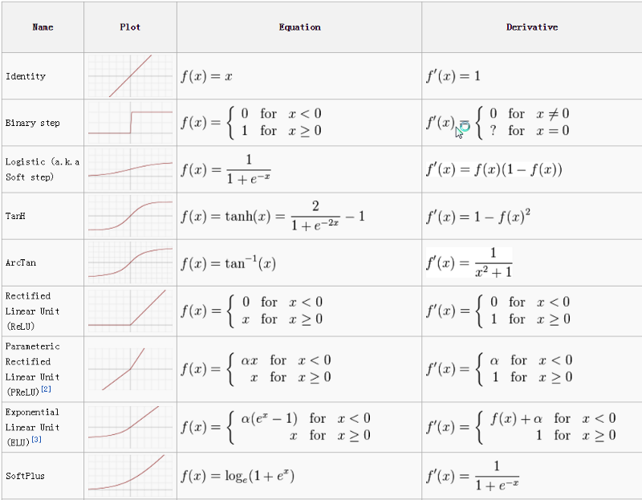
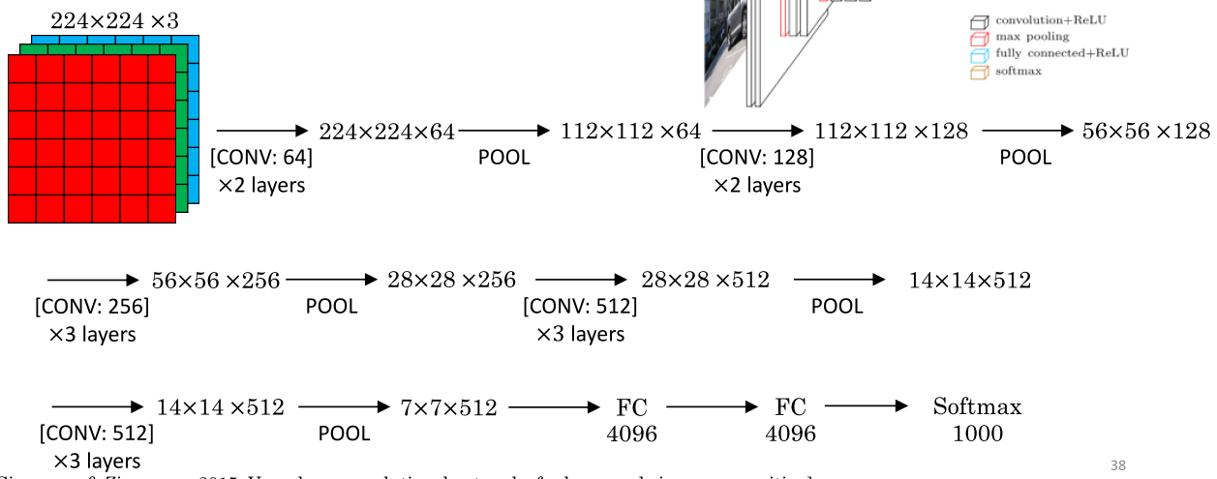
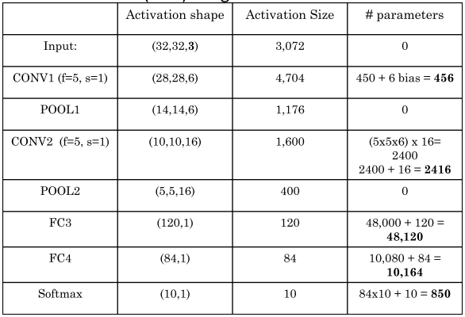
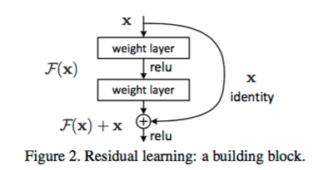
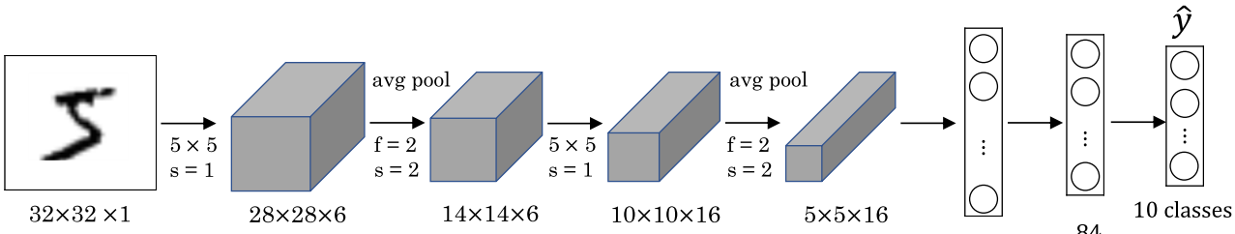
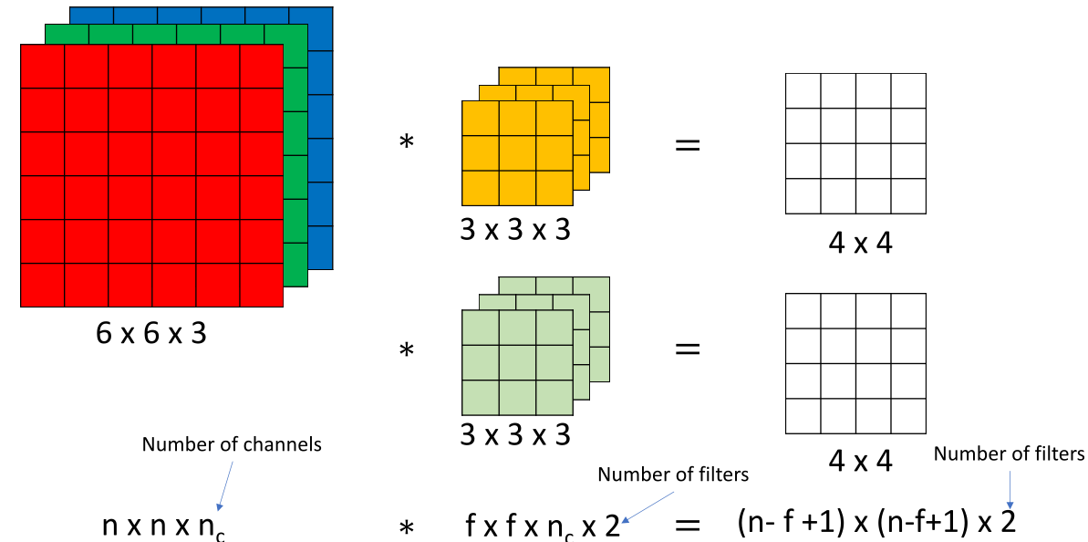
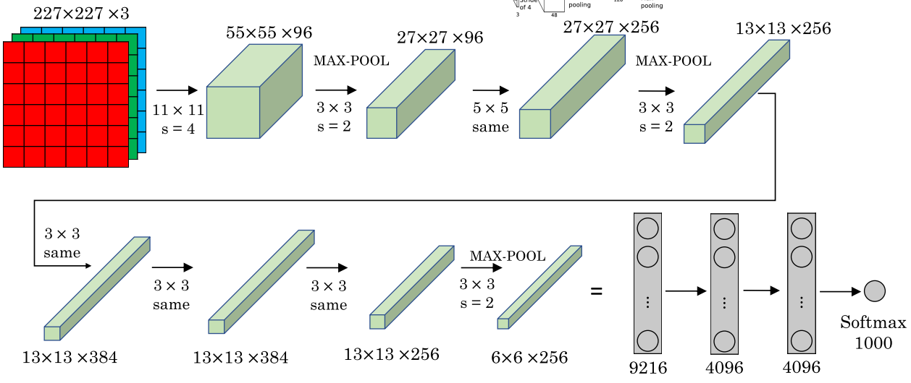
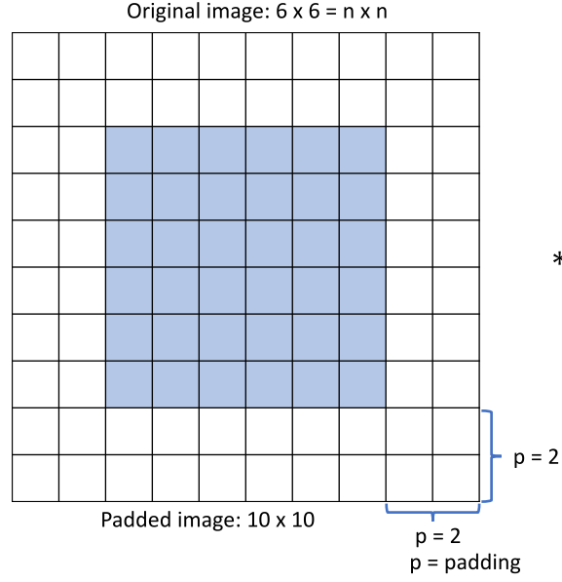
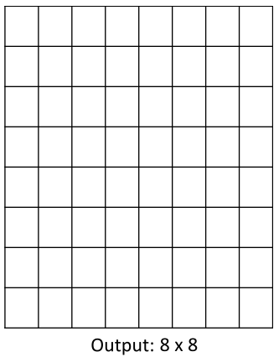
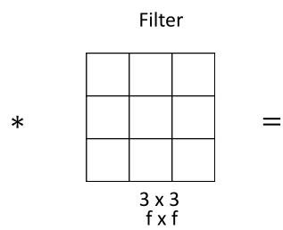

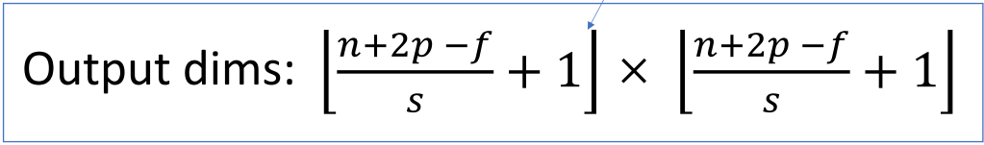
Parameter Sizes
Consider a convolution layer. The input consists of 6 feature maps of size 20 × 20. The output consists of 8 feature maps, and the filters are of size 5 × 5. The convolution is done with a stride of 2 and zero padding, so the output feature maps are of size 10 × 10
Determine the number of weights in this convolution layer.
Solution:
There’s one filter for each pair of an input and output feature map, and the filters are each 5 × 5. Therefore, the number of weights is 6 × 8 × 5 × 5 = 1200.
Now suppose we made this a fully connected layer, but where the number
of input and output units are kept the same as in the network described above.
Determine the number of weights in this layer.
Solution:
There are 20x20x6 units in the input layer and 10x10x8 units in the output layer, so the number of weights is 20x20x6x10x10x8=1,920,000
Parameter Question 2:
How many parameters do we have in a conv layer with 100 filters that are 3x3x3 dimensional each?
For one filter: 3x3x3=27filter weights; and =1 bias = 28 parameters
For all 100 filters: we have 28x100=2800 parameters
VGG16
It makes the improvement over AlexNet by replacing large kernel-sized filters(11 and 5 in the first and second convolutional layer, respectively) with multiple 3X3 kernel-sized filters one after another. With a given receptive field(the effective area size of input image on which output depends), multiple stacked smaller size kernel is better than the one with a larger size kernel because multiple non-linear layers increases the depth of the network which enables it to learn more complex features, and that too at a lower cost. Inefficient, but accurate due to large width of convolutional layers
Relu vs Sigmoid vs Tanh:
The advantage of the ReLu over sigmoid is that it trains much faster than the latter because the derivative of sigmoid becomes very small in the saturating region and therefore the updates to the weights almost vanish(Figure 4). This is called vanishing gradient problem.
Inception: Let us take the first inception module of GoogLeNet as an example which has 192 channels as input. It has just 128 filters of 3X3 kernel size and 32 filters of 5X5 size. The order of computation for 5X5 filters is 25X32X192 which can blow up as we go deeper into the network when the width of the network and the number of 5X5 filter further increases. In order to avoid this, the inception module uses 1X1 convolutions before applying larger sized kernels to reduce the dimension of the input channels, before feeding into those convolutions. So in the first inception module, the input to the module is first fed into 1X1 convolutions with just 16 filters before it is fed into 5X5 convolutions. This reduces the computations to 16X192 + 25X32X16. All these changes allow the network to have a large width and depth.
inception module that approximates a sparse CNN with a normal dense construction(shown in the figure). Since only a small number of neurons are effective as mentioned earlier, the width/number of the convolutional filters of a particular kernel size is kept small. Also, it uses convolutions of different sizes to capture details at varied scales(5X5, 3X3, 1X1).
Residual Network: Imagine a network, A which produces x amount of training error. Construct a network B by adding few layers on top of A and put parameter values in those layers in such a way that they do nothing to the outputs from A. Let’s call the additional layer as C. This would mean the same x amount of training error for the new network. So while training network B, the training error should not be above the training error of A. And since it DOES happen, the only reason is that learning the identity mapping(doing nothing to inputs and just copying as it is) with the added layers-C is not a trivial problem, which the solver does not achieve. To solve this, the module shown above creates a direct path between the input and output to the module implying an identity mapping and the added layer-C just need to learn the features on top of already available input. Since C is learning only the residual, the whole module is called residual module.
Alex-net
Padding:
Pad so output size matches input size:
P=(f-1)/2
Uses ReLu has 5 convolutional layers and 3 fully connected layers. Uses dropout to reduce over-fitting. Dropout randomly switches off the activation. Due to the dropout layer, different sets of neurons which are switched off, represent a different architecture and all these different architectures are trained in parallel with weight given to each subset and the summation of weights being one. For n neurons attached to DropOut, the number of subset architectures formed is 2^n. So it amounts to prediction being averaged over these ensembles of models. This provides a structured model regularization which helps in avoiding the over-fitting. Another view of DropOut being helpful is that since neurons are randomly chosen, they tend to avoid developing co-adaptations among themselves thereby enabling them to develop meaningful features, independent of others.
Output Size with Stride:
Image dims: nxn
Filter dims: fxf
Padding: p
Stride: s

